Slide 1

Sarah Sweeney
Digital Repository Manager
Northeastern University Libraries
repository.library.northeastern.edu
Notes:
Promotional Slide

Slide 2
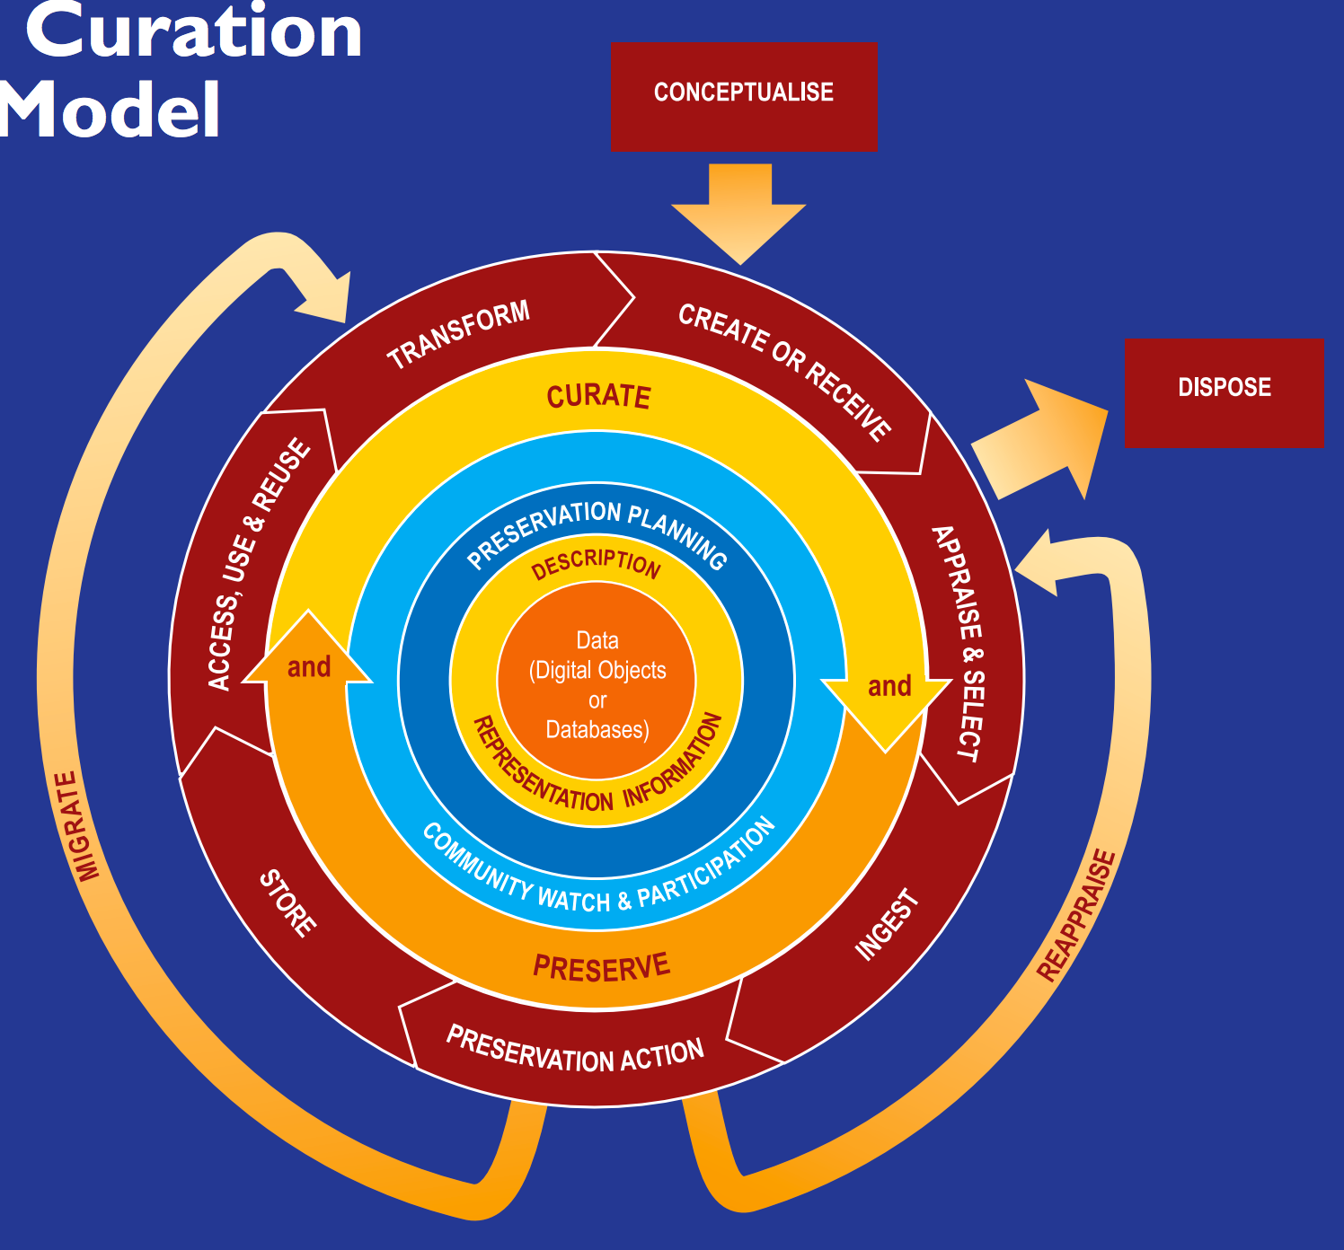

Slide 5
References

Slide 6
DRS
Resources
Contact
https://repository.library.northeastern.edu
http://library.northeastern.edu
sj.sweeney@neu.edu
Sarah Sweeney
Digital Repository Manager
Northeastern University Libraries
repository.library.northeastern.edu
Notes:
Promotional Slide

